Slide 1
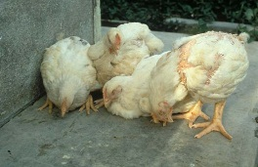
poultry diseases 2 (u3u3enh)
fourth stage
شعار الكلية
chapter three – Viral Diseases- lecture 6
PART 1
Runting –stunting Syndrome (RSS)
Dr.Harith Abdulla
Department of Pathology and Poultry Disease
College of veterinary medicine university of basrah
University of Basrah- College of veterinary medicine- Department of Pathology and Poultry Disease

Slide 2
RSS
Is a disease syndrome with several names , characterized by lowered body weight and described as runting-stunting, pale bird, malabsorption syndrome, brittle bone and helicopter wing syndrome. It is a disease of young birds associated with delayed growth , and runts during the first 2-3 weeks of age .

Slide 3
Etiology :
Several viruses like reovirus,
bacteria and other pathogens.

Slide 4
Clinical signs
1- Severely delayed growth Low uniformity.
2- Pale and stunted.
3-Watery diarrhea soiled vents Damp litter.
4-No early mortality : Late mortality may be high.
5-Occurs at 6-7 days of age , the usual peak of the problem occurs
at around 10-12 days of age .

Slide 5
6-a/ As feathers appear on affected birds, smaller than normal and
may be curled especially at the wing tips ( Helicopter Disease ).
b- The legs and beak of affected birds may appear pale in color
( Pale Bird Syndrome ).
c- Some birds may have rickets or broken legs ( Brittle Bone
Disease ).

Slide 6
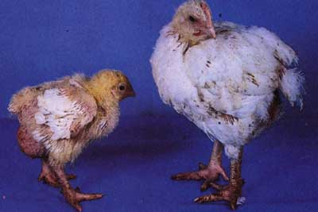
Low uniformity

Slide 7
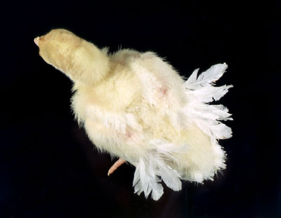
Helicopter Disease

Slide 8
Post-mortem lesions :
1- Small livers with a grossly enlarged gallbladder.
2- Pale , thin , almost translucent intestinal wall with wet
pellets of undigested food visible through the intestinal wall.
3- Large amount of fluids inside the small and large intestines.
4- Feed cloacal impaction.
5- Increased amount of pericardial fluid.
6. White or cream-colored plaques in the proventricular glands.

Slide 9
Microscopically:
1- Cystic enteritis.
2-Pancreatitis pancreatic degeneration/ fibrosis.
Transmission :
1- Vertical transmission.
2- Lateral transmission.

Slide 10
Diagnosis:
1- Signs.
2-Lesions.
3-ELISA.
Differential diagnosis :
1- Mycoplasma synoviae .
2-Staphylococcal arthritis.
3- Spontaneous rupture of the gastrocnemius tendon.
4-Colibacillosis (Synovitis).

Slide 11
Control :
1- Biosecurity .
2- Good poultry house management.
3-Vaccination.
Prevention :
1- RSS agents are heat–sensitive.
2- Thermal treatment of litter.

